Slide 1




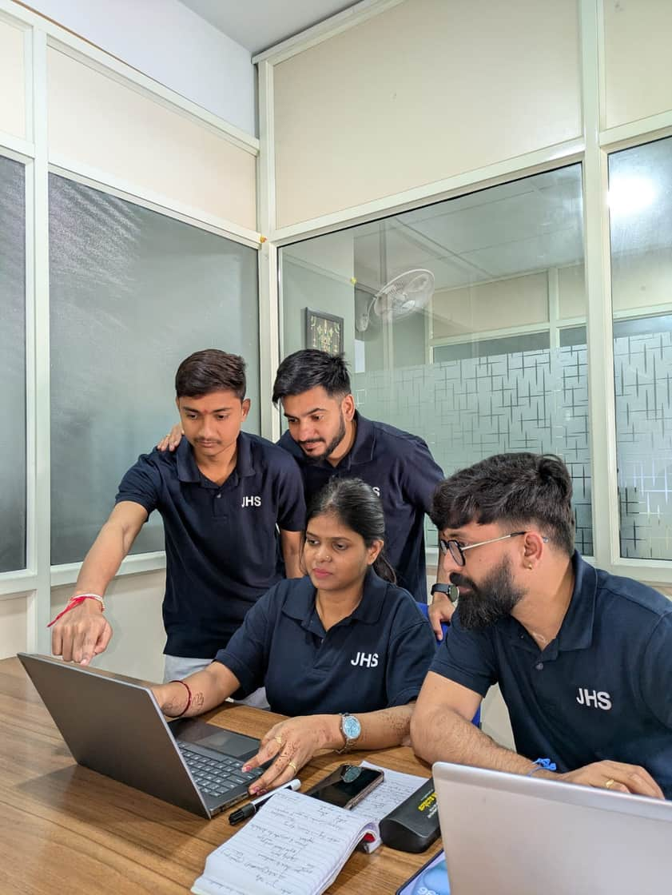
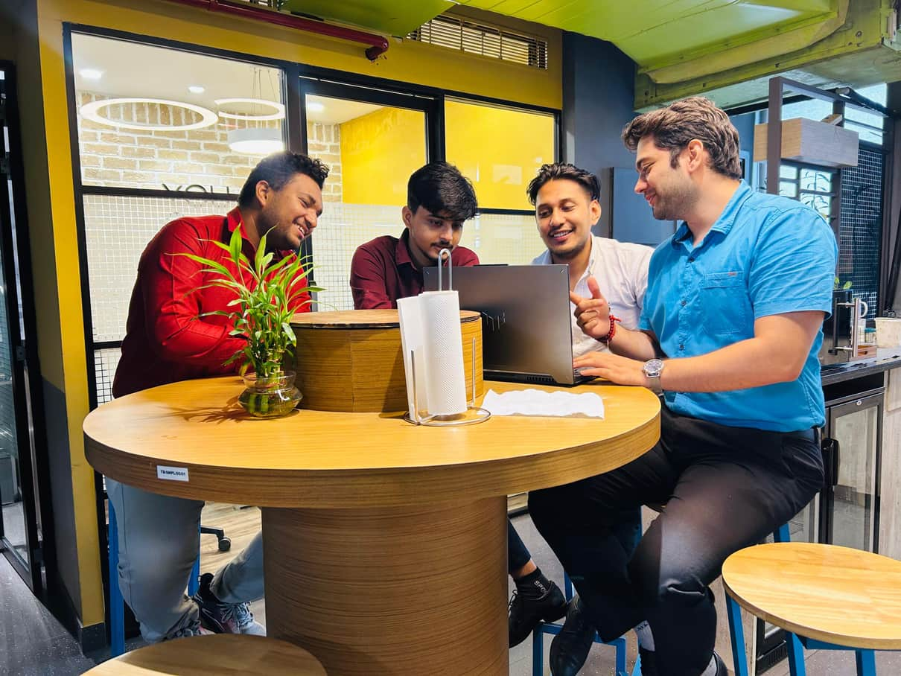
Business Profile
“Building trust. Delivering excellence. Shaping better futures.”
https://jhsassociates.in/
1

Slide 2

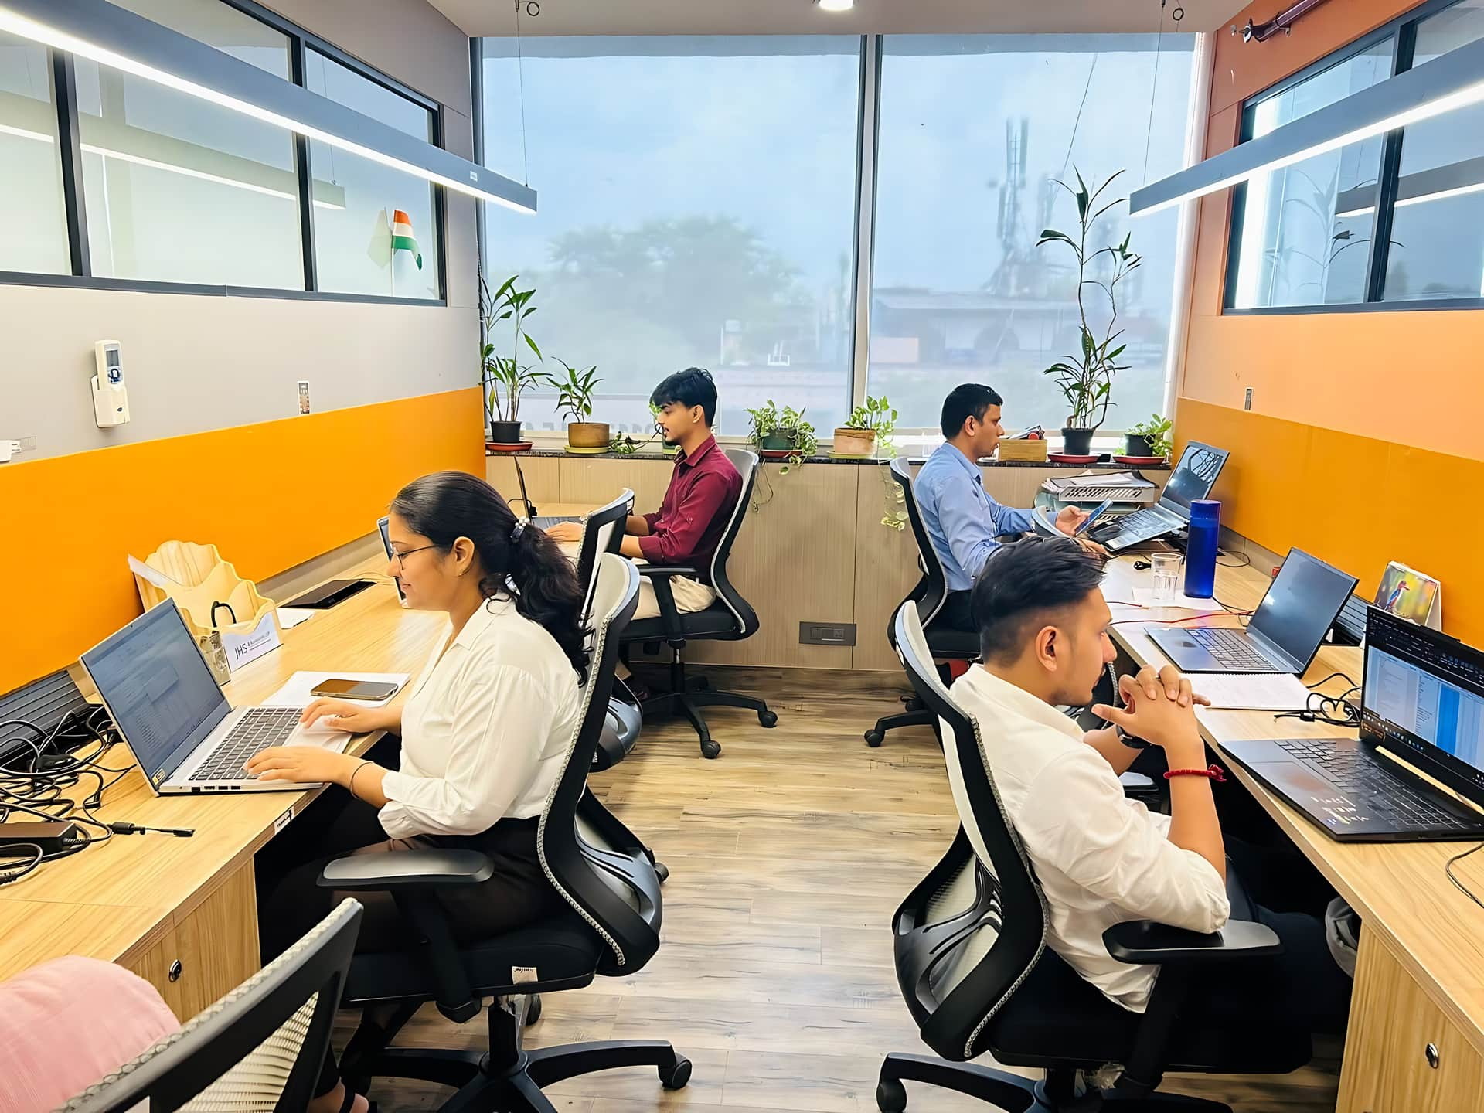




Our Legacy & Capabilities
Incorporated on 28ᵗʰ February 1981.
Serving 1000+ clients with trust & excellence
Tailored delivery, trusted advice, and clear foresight.
700+ professionals delivering nationwide solutions
14 branches ensuring pan-India reach
2

Slide 3

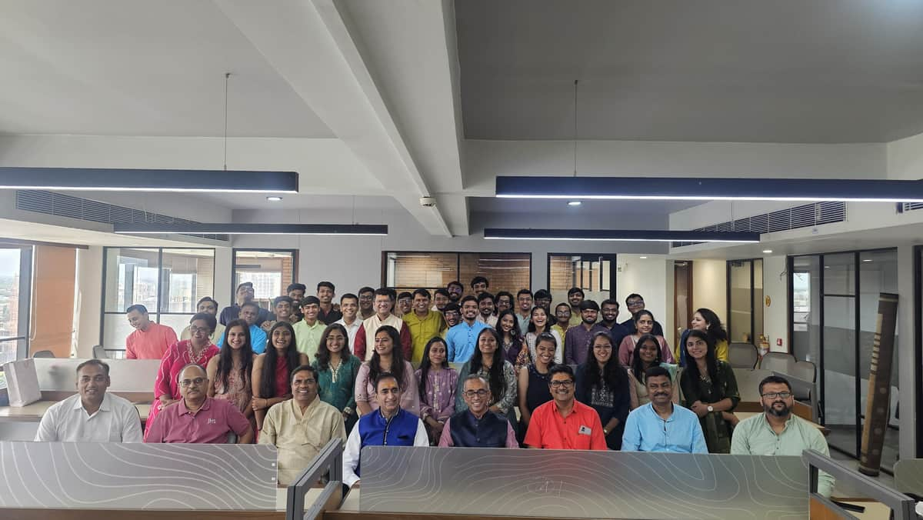
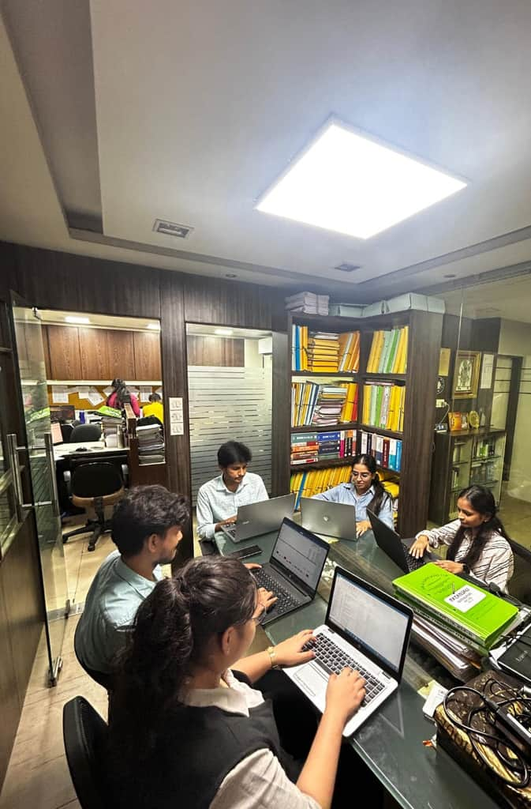
Expertise You
Can Rely On
End-to-End Expertise.
All services under one roof, backed by a partner-led, proximity-based engagement model.
Backed by Trust, Built for Impact
Technology that Drives Results.
At JHS, we go beyond traditional advisory, combining deep knowledge, agile execution, and holistic support to help businesses thrive. Our strength lies in delivering consistent value through insight, innovation, and integrity.
We partner with clients as enablers of growth, not just service providers. Our people-first mindset ensures every engagement is collaborative, transparent, and tailored. We bring the stability of a legacy firm with the agility of a modern one.
Responsive execution powered by dashboards, automation, and simplified compliance.
Strategic. Secure. Reliable.
Strategic delivery designed to reduce risk, minimise cost, and uphold trust.
Workforce & Efficiency
With almost 49% women in our workforce and the inclusion of differently-abled team members, we champion equal opportunity, foster diversity, uphold integrity, and remain committed to delivering quality services.
3

Slide 4
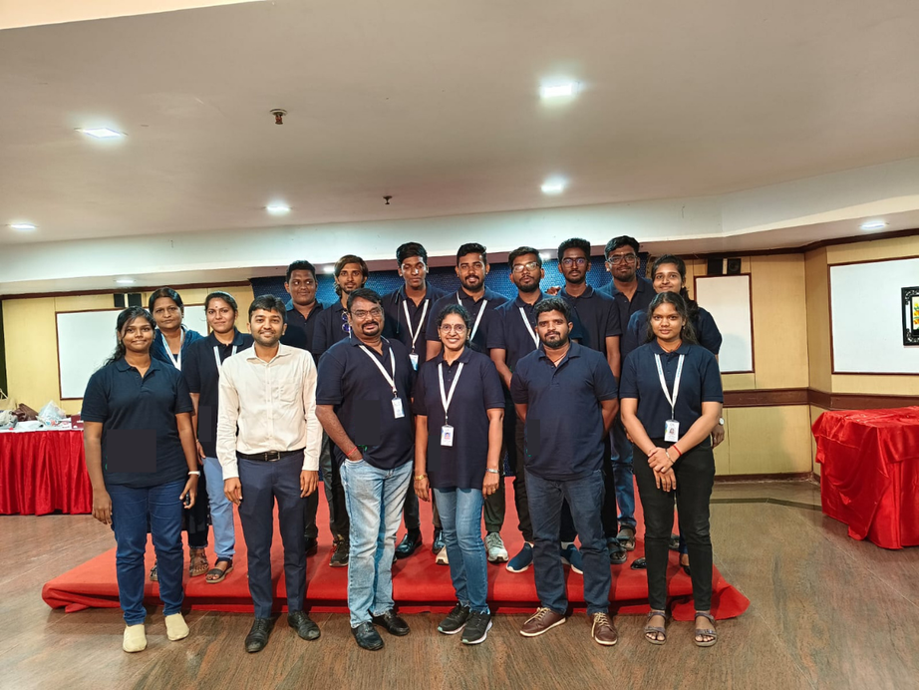


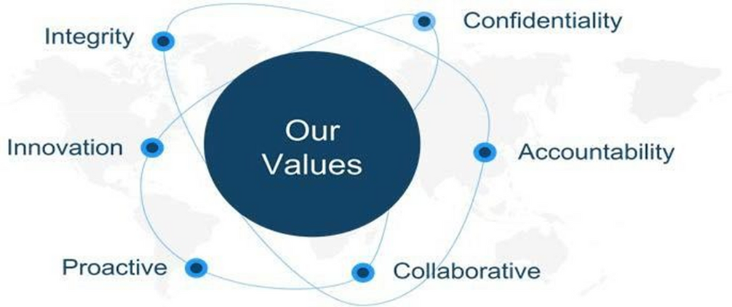
OUR VISION & MISSION
Our Vision
To be a globally respected premier assurance & accounting firm that is most preferred in locations we serve.
Our Mission
To nurture people and enable them to offer value to our clients through innovation, technology & responsiveness.
4

Slide 5






KEY DIFFERENTIATORS
Full array of services under one roof
Proximity to client locations
Partner driven engagement
End-to-end services: compliance, risk management, training, transformation, payroll, staffing & global setups.
Multiple offices across India, we reduce distance so your needs are met faster with better insight and partnership.
We adapt and integrate with your team to ensure our advice is practical and aligned with your long-term strategy.
Dashboards and Insights
Quick response to client needs
Client-centric approach
Dashboards and Insights that provide real-time analysis reports and a clear view of your organization.
Fast, Reliable, Responsive. Your needs are met with Agility. We act quickly and deliver solutions without waiting
We build our work to reflect your business, goals and your growth plan. You lead, we facilitate and execute.
5

Slide 6






VALUE PROPOSITION
Effective risk and cost management
Deep knowledge
insights
Safeguarding reputation through assurance services
Simplifying compliance complexities
Process efficiency and digital transformation
6

Slide 7





JHS GOLD STANDARD
QUALITY
Delighting stakeholders by exceeding expectations.
Aiming for excellence by maintaining high standards of professional practice and service execution.
Displaying high levels of commitment and passion.
FAIRNESS IN DEALINGS
Fairness in dealings with customers, employees and vendors.
Open and co-operative dealings with regulators.
OBJECTIVITY
Committing to integrity, independence & accountability adds value to clients as an objective source of advice and assurance.
RESULT ORIENTED APPROACH
Analytical thinking coupled with business understanding and problem-solving.
Working as a catalyst for improvement through effective assessment of opportunities & risks.
Personalized attention to clients and result orientation.
MUTUAL TRUST & RESPECT
Working relationships are based on fulfilling commitments to develop trust.
Honesty and integrity as the best business ethics.
Transparent dealings.
7

Slide 8






Professional Solutions
ASSURANCE
CONSULTING
TAXATION
Enhancing trust through reliable, transparent financial reporting.
Strategic guidance to drive growth, efficiency, and transformation.
Expert tax planning and compliance for smarter financial outcomes.
OUTSOURCING
CORPORATE FINANCE
COMPLIANCE, LEARNING & INNOVATION
Reliable back-office support
So you can focus on
core growth.
Smart capital strategies for growth and risk management.
Strengthening governance and managing risk for sustainable growth.
8

Slide 9




Statutory & Internal Audits for companies, trusts, funds, and firms
01
07
Channel, Dealer & Branch Partner Audits
IT, Cyber Security, and Digital KYC Audits
02
08
Supply Chain & Distribution Partner Audits
Mystery/Decoy Shopping & Forensic Audits
03
09
IPO, SOC & SSAE-21 Certification Audits
Assurance Solutions
Concurrent & Continuous Monitoring Audits
04
10
Ethics, ESG, Donor & End-Use Audits
Tax Audit & Transfer Pricing Certification
05
11
Related Party Transactions & Remittance Certifications
GST Health Check & Revenue Audits
06
12
Physical Asset Verification, Data Purging & Stock Destruction Audits
9

Slide 10
Company Incorporation and regulatory setup services
01
07
Secretarial Practice, Company Law Compliance & Due Diligence
Internal Financial Controls, SOP design & automation
02
08
Internal Control Evaluation, Business Impact & Continuity Planning
Risk Management Frameworks and fraud investigations
03
09
Annual Return Filing, and statutory compliance management
Consulting
Services
Business Advisory, Valuation,
and field verification studies
04
10
Merger, Acquisition, Demerger & Reorganization Planning
Efficiency Improvement and process optimization consulting
05
11
Financial Forecasting, Working Capital & Business Valuation Support
Family Arbitration, Private Trust & Succession Planning
06
12
FEMA Advisory, Project Feasibility Reports & Liquidation Assistance
10

Slide 11
Representation before tax authorities for assessments, refunds & rectifications
01
07
Survey, Search & Seizure Support
Tax structuring, budgeting, forecasting & M&A advisory
02
08
Scrutiny & Faceless Representation
Corporate & Non-Corporate Return Filing (Direct Tax)
03
09
Assessments, Appeals & Litigation
Taxation Solutions
Tax Planning, TDS &
Advance Tax Compliance
04
10
Transfer Pricing (Domestic & International), Reviews & Certifications
GST Return Filing, Retainership & Indirect Tax Advisory
05
11
International Tax & Inbound/Outbound Structuring
Tax Advisory, GST Health Check & Dispute Resolution
06
12
Tax Audits, Digitalization, Registration (PAN, GSTIN, TAN, Charitable Trusts)
11

Slide 12
Accounting system selection, design &implementation
01
07
Inventory Verification & Payroll Processing
Budgeting & Monitoring Financial Reporting
02
08
Virtual CXO Services (CEO, CFO, CTO, CPO)
MIS, global & domestic bookkeeping, and full compliance management.
03
09
Accounting, Reporting & AP/AR Reconciliation
Outsourcing Solutions
Corporate Training
04
10
Cloud Office Setup, Automation & Support
Tax Return Preparation (Federal, State, GST/VAT, Payroll, FBAR)
05
11
Remote Secretarial Services
Fixed Asset Management (Verification to Reconciliation)
06
12
Risk Assessment & Register Maintenance
12

Slide 13
Project Finance, ECB, Debt
01
05
Valuation, Due Diligence
Capital Markets, IPO & PE Advisory
02
Corporate Finance Solutions
06
Treasury, Controls
Business Plans & Projections
03
07
CFO Services
Mergers & Acquisition
04
11
Govt. & Infra. Advisory
13

Slide 14
Compliance & Governance Solutions
01
07
Board Meeting & AGM Compliance
Compliance Awareness Sessions & Corporate Learning Programs
02
08
Filing Annual Returns & Statutory Documents with Regulatory Authorities
Enterprise Risk Identification & Assessment Across Business Functions
03
09
Maintenance of Statutory Registers, Board Resolutions, Shareholding Patterns & KMP Records
Compliance, Learning & Innovation
Risk Mitigation Strategy Development, Implementation & Continuous Monitoring
04
10
Regulatory Liaison & Representation Support
Internal Reviews to Ensure Compliance & Evaluate Internal Controls
05
11
Governance Framework Development & Control Environment Assessment
Company Incorporation & Drafting of Memorandum and Articles of Association
06
12
External Audit Support, Review Assistance & Control Improvement Advisory
14

Slide 15
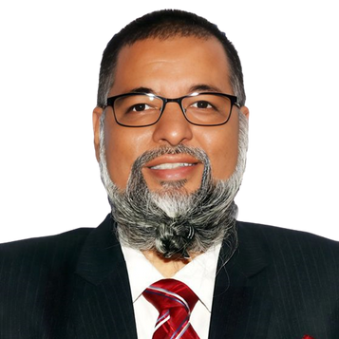

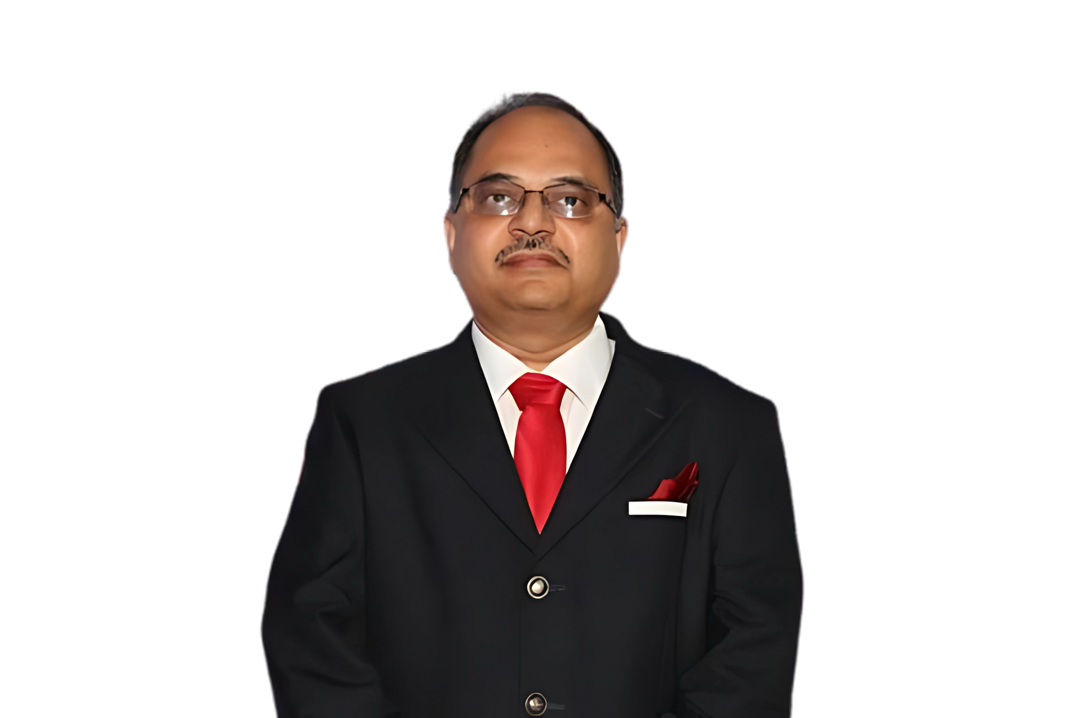
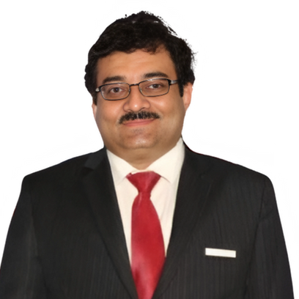
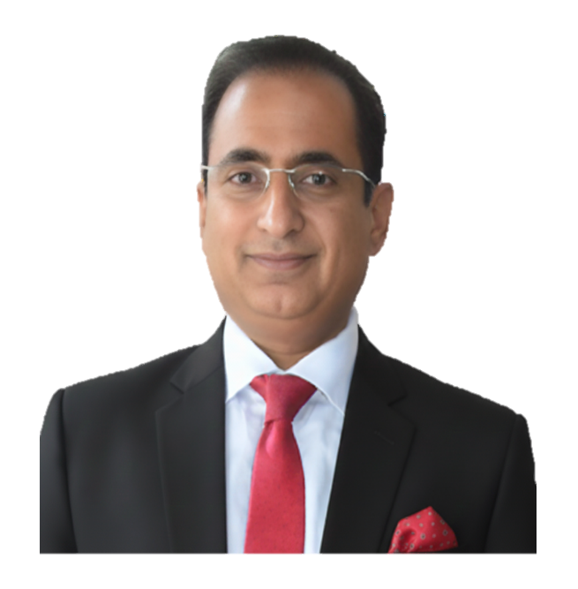
GOVERNANCE BOARD
HUZEIFA UNWALA
NIKHEL KOCHHAR
KALPESH PARMAR
SHARAD MOHATA
VINOD
JOSHI
FCA, CISA, ISO 27001, NISM(DP),
NISM(Social Auditor)
FCA, CIA
B.Com (Hons), FCA
B.Com (Hons), FCA, ICWAI
FCA, MBA (Finance)
15

Slide 16

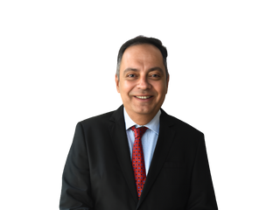
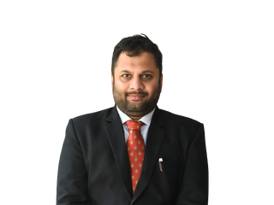
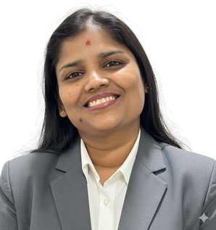
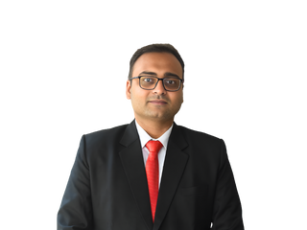
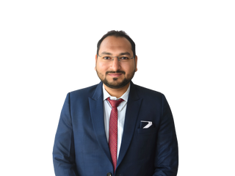
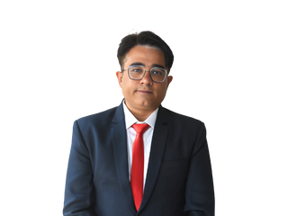

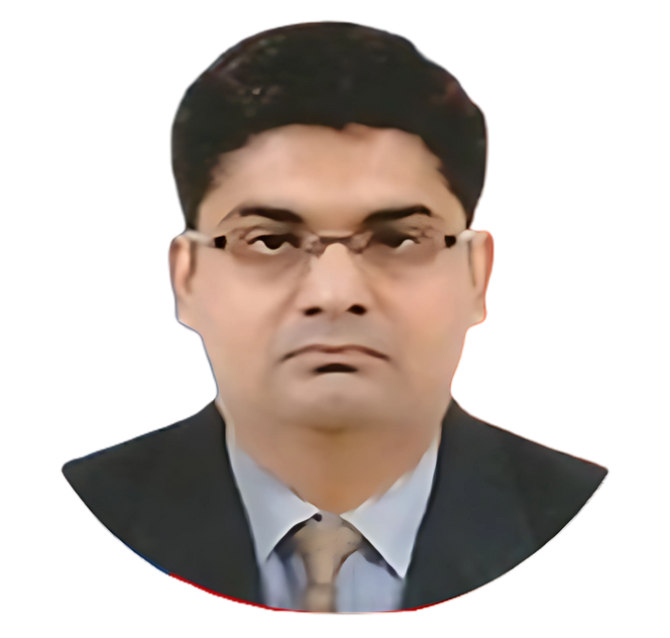
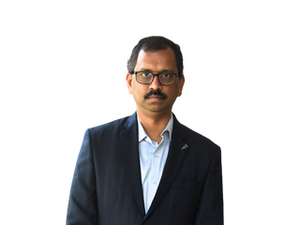
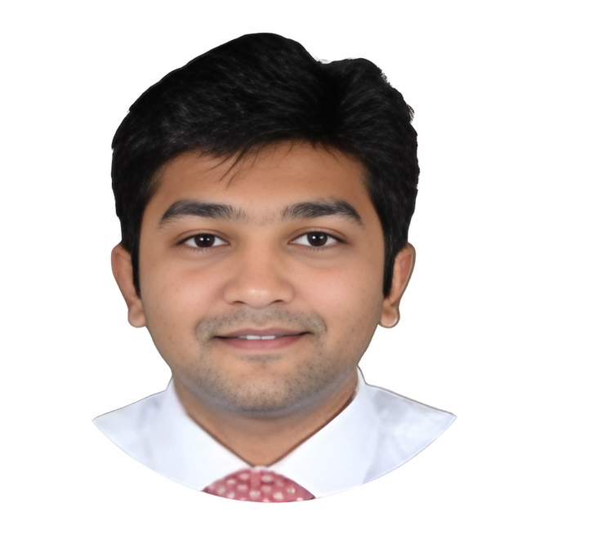

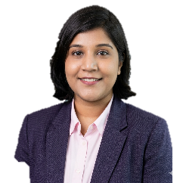

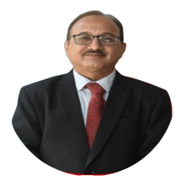

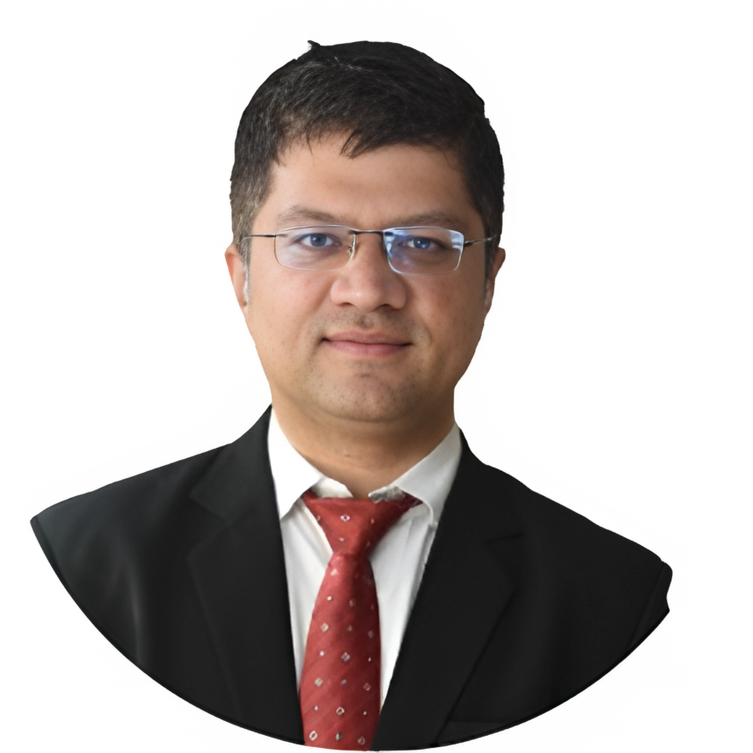
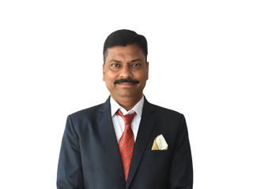
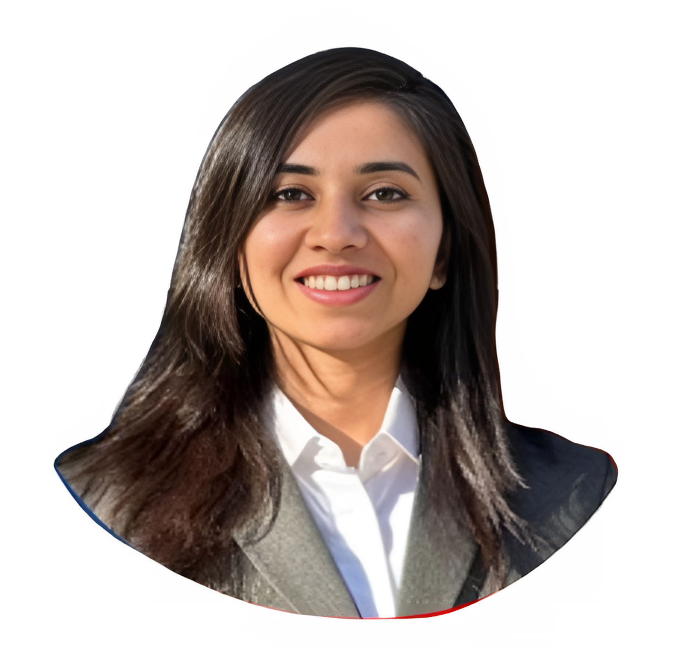
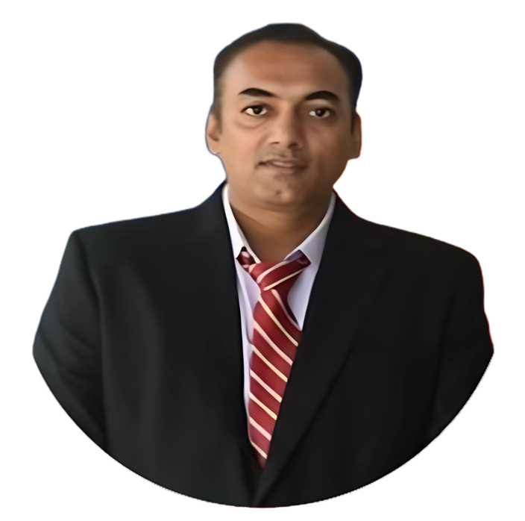
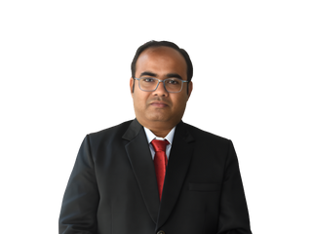
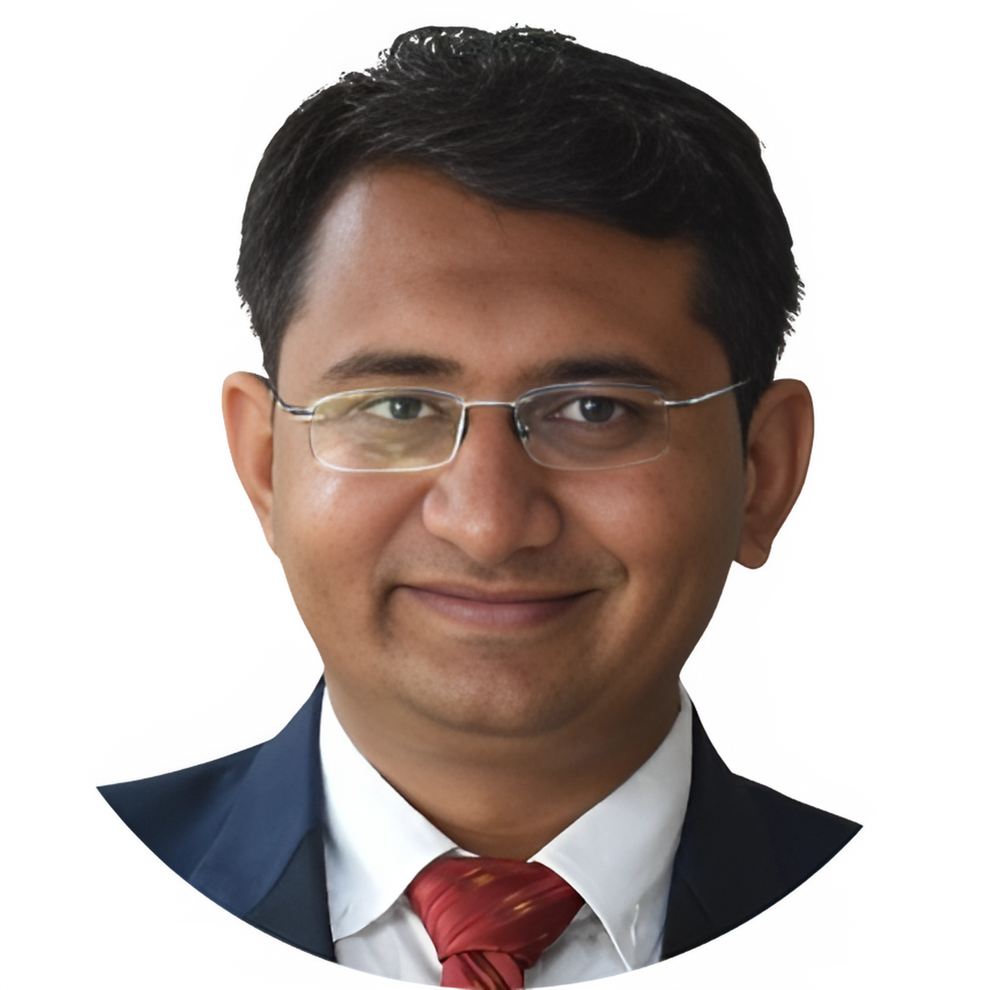
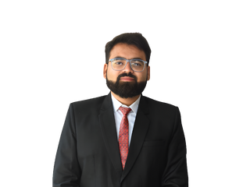
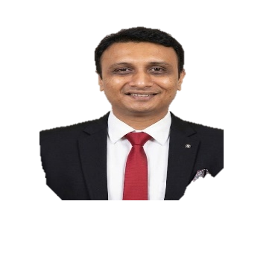
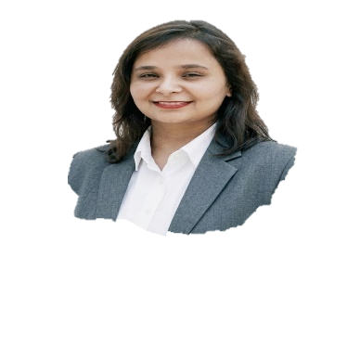
MUMBAI PARTNERS
TASNIM TANKIWALA
JAMAL CHATRIWALA
TAHER PEPERMINTWALA
DHANLAXMI NAIR
SAHIL
SHAH
TAUSIF SHAIKH
SAMAD DHANANI
DISHA
SHAH
FCA | IND AS & IFRS | Statutory Audit
B.Com, ACA
IA & Risk Advisory, Insurance
B.Com, FCA, CISA, ACCA | Assurance & Tech | SOC Audit Expert
M.COM, FCA,
SET & CMA
B.Com, ACA
Risk Advisory, IA, IFC & IPO Certification
B.Com, ACA
Assurance & Tax
M.Com, CS, ACA
Statutory & Accounts Outsourcing
FCA,
Risk Advisory, IA & IFC
BENGALURU, CHENNAI, DELHI & HYDERABAD PARTNERS
JAGDISH SOLANKI
NARAYANA RAO MALLA
PRANAL P
CHANDRA SEKARAN
GEETHIKA GHANTA
NM PRADEEP
B.Com (Hons), FCA, Direct & Indirect Tax,
B.Com, FCA | IA & Risk Advisory, FMCG & Retail
B.Com, FCA
Specialising in GST
BA, DSM, FCA, DISA
CA, Taxation & Audit Specialist
CA, CMA & Indirect Tax & Advisory
GUJARAT PARTNERS
VIRENDRA NAYYAR
SAURABH SHAH
DHAVAL THAKKAR
VIRANCH MODI
SHREENA PANARA
MILIN PAREKH
MEHUL
SHAH
ALPESH VANIYA
RAJ
SHAH
PARTH
SHAH
JHANKHNA PATEL
B.Com (Hons), FCA | IA & Assurance
B.Com, FCA, DISA | Direct & Indirect Tax
B.Com, ACA
IA & Risk Advisory, Insurance
B.Com, FCA
Income Tax & GST
B.Com, ACA
Indirect Tax
M.Com, FCA
IA & Consulting
B.Com, FCA
Income Tax & GST
B.Com, ACA
IA & Tax Consulting
B.Com, ACA
Tax Litigation & Advisory
B.Com, FCA, Financial Strategy Specialist
(Associate Partner)
CPA (Aust.), FCA, CBAP, DISA & ESG Specialist
(Associate Partner)
16

Slide 17








JHS OFFICES
Unit No. B-406 to 410, 4th floor, Navkar Chambers, Marol Naka Metro Station, Andheri (East). Maharashtra – 400059
Unit No 11-12,Regency Avenue, Murbad Road Kalyan (West).
Maharashtra - 421301
Unit No.402, 4th floor,
Nav Vyapar Bhavan, 49 P.D’mello Road, MB
Maharashtra - 400009
Shop No. 11A, 345,
New Sai Niketan CHS Ltd.
Dr Mascarenhas Road, Mazgaon, Mumbai – 400010
H.O. ANDHERI
KALYAN
MASJID BUNDER
MAZGAON
Level 10, 1016–21,
Swati Clover, Shilaj Circle,
Sardar Patel Ring Road,
Thaltej, Ahmedabad,
Gujarat – 380054
4th floor, Lila Chambers,
Notus Pride,
Vadodara.
Gujarat-390023
B 303, Kings Heights, Vidya Kunj Society, Main Road, Near Amin Marg, Rajkot, Gujarat - 360001
504, 5th Floor, Shubh square. Opp Venus Hospital, Lal Darwaja, Gotalawadi Road,
Gujarat – 395003
Unit No.101, Saga Casa,
Daulat Nagar, Vapi.
Gujarat - 396215
AHMEDABAD
VADODARA
RAJKOT
SURAT
VAPI
3rd Floor, Aria, No. 541 AECS Layout Main Road, Above Costa Coffee, Bangalore – 560 037
Unit No.306,
DIF Centre, Savitri Cinema Complex,
Delhi - 110048
Unit No.402, 4th floor, Vardhan Complex, 25A Camac Street, Kolkata.
West Bengal - 700016
No: 43/65,
South West Boag Road,
T-Nagar,
Chennai – 600017
6-3-788/36 & 37/A, "Badhe House", First Floor, Ameerpet, Durganagar, Hyderabad,
Telangana - 500016
BENGALURU
DELHI
KOLKATA
CHENNAI
HYDERABAD
17

Slide 18





Let's Connect!
18001201022
+91 80970 93034
connect@jhsassociates.in
https://jhsassociates.in
Your goals. Our expertise. One partnership that delivers.
Get in touch and let’s start a conversation that transforms challenges into opportunities.
https://jhsassociates.in/
18

